Slide 1
Social Dialects
Charalambos Themistocleous
www.charalambosthemistocleous.com
www.themistocleous@gmail.com

Slide 2
reVIEW
Language
Dialect-Sociolect
Accent

Slide 3
Criticisms of traditional dialectology
long questionnaires
Only a small part of the population: non-mobile, old, rural men (NORMs)
with one-word answers, to questions such as: 'You sweeten tea with…..?' and 'What do you say to a caller at the door if you want him to enter?' The answers to the questions were then transcribed phonetically by the survey worker.

Slide 4
firstly, that dialectology should not just be interested in the very small proportion of the population who were old, rural and male, but also include the young, women and those living in towns and cities.
Secondly, they argued that one-word answers to questionnaires were too divorced from everyday language to provide a really accurate account of how people used language - critics suggested that dialectology should study continuous and relaxed conversation which not only would provide examples of more everyday language but also highlight variability within the speech of the individual.

Slide 5
STYLES
REGISTERS
BELIEFS
and more about: SOCIOLECTS

Slide 6
STYLE
Formal
Public Lectures
Ceremonies
Informal
Conversations on informal matters
Casual Conversations

Slide 7
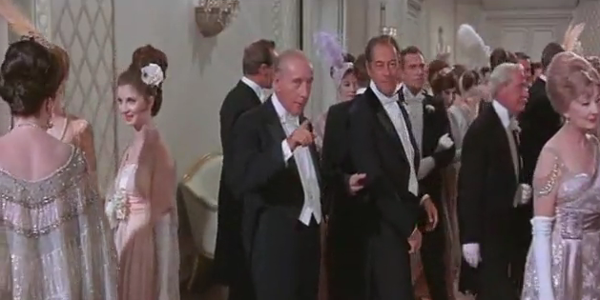
STYLE
The level of formality depends on:
The kind of the occasion
Age
Social status
The task that participants are involved with
Etc.

Slide 8
Register
It’s a kind of variety.
“People participating in recurrent communication situations tend to develop similar vocabularies, similar features of intonation, and characteristic bits of syntax and phonology that they use in these situations”.
Ferguson (1994:20)

Slide 9
CHANGE THE SLIDE THERE IS NOTHING HERE!!!

Slide 10
Ferguson adds that this variety’s “special terms for recurrent objects and events, and formulaic sequences or “routines”, seem to
facilitate speedy communication;
serve to mark the register
establish feelings of rapport
Serve other purposes similar to the accommodation that influences dialect formation.

Slide 11
One person may control a variety of registers.
People may ascribe different values to others depending on how good or bad they are in utilizing a register.

Slide 12
Social Dialectology
Some sociolinguists argue that Standard English can only be used properly to refer to features of grammar and vocabulary.
Other sociolinguists (Milroy 1992; Mugglestone 2003) find the term ‘standard’ useful for discussing attitudes to different accents.
What do you think about Milroy’s proposal what kind of attitudes?

Slide 13
Cities
Cities are much more difficult to characterize linguistically than rural hamlets.
Variation in language and patterns of change are much more obvious in cities:
Family structures
employment
opportunities for social advancement or decline.
Migration, in and out of cities
Cities also spread their influence far beyond their limits > play a role in standardization

Slide 14
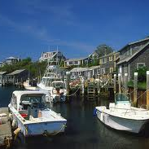
Martha’s Vineyard study (1963)
By William Labov

Slide 15
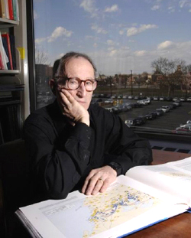
William Labov
1927, Rutherford NJ
originally an industrial chemist
got interested in linguistics, studied for MA (1963) and PhD (1964) at Columbia University, studying varieties of English in New York City
innovative and influential methodology
later (1971) professor at U Penn

Slide 16
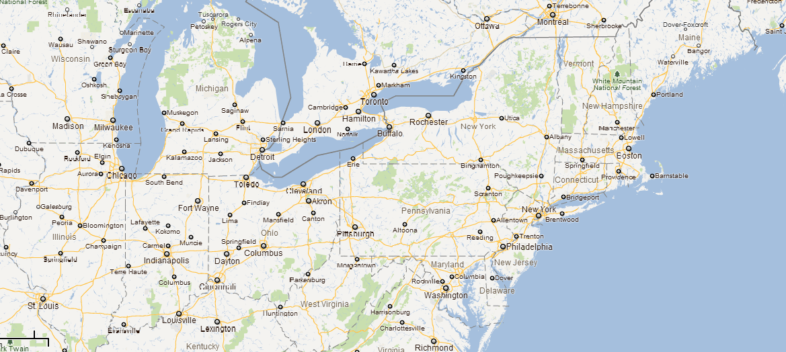
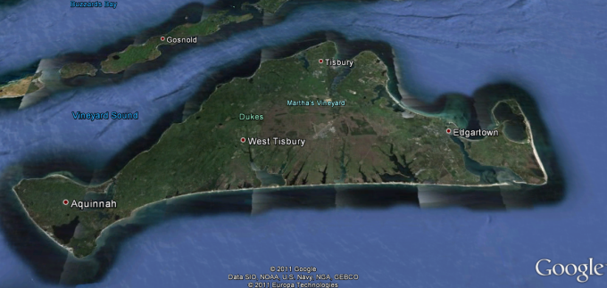
Labov: Martha’s Vineyard /ˌmɑːθəz ˈvɪnjəd/
The first social study was conducted in the summer of 1961 on Martha’s Vineyard an island off the coast of Massachusetts in the north eastern United States.

Slide 17
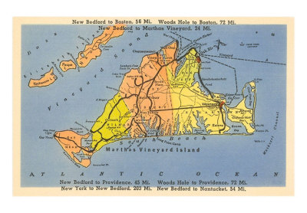
Martha’s Vineyard study (1963)
Martha's Vineyard is an island about 3 miles off New England on the US East Coast
Permanent population ~ 6000.
Big influx of visitors in summer ~40,000
Eastern part of island “Down Island” more densely populated, and favoured by visitors
Permanent population consists of Yankees (descendants of early settlers), Portuguese (more recent immigrants) and Native Americans Western end “Up Island” has more original inhabitants and is strictly rural especially around Chilmark, centre of once important fishing industry: 2.5% of population still involved in fishing Chilmark fishermen very close-knit and most antipathetic to the “summer people” Regarded by other islanders as independent, skilful, physically strong, courageous

Slide 18
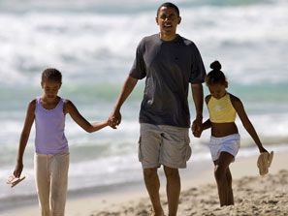

Slide 19
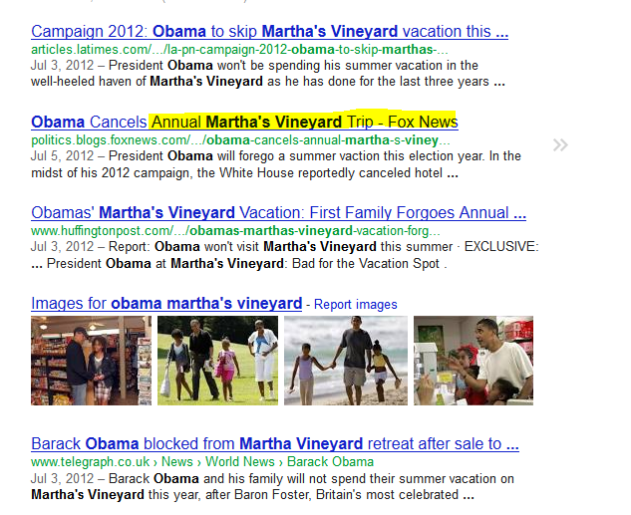

Slide 20
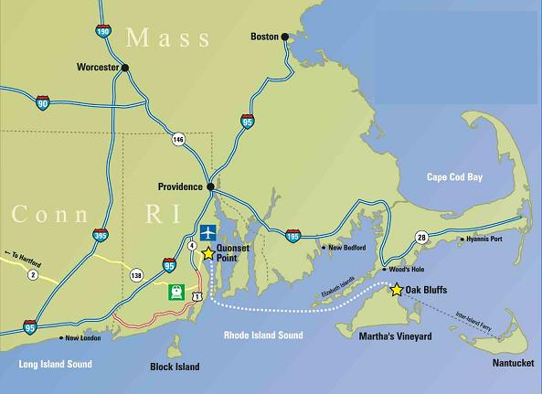
Labov’s study
Focused on pronunciation of /au/ (as in out, house trout) and /ai/ (as in while, pie, might)
Noticed that locals had a tendency to pronounce these diphthongs with a more central start point [əu, əi]
Collected data by interviewing 69 informants, talking generally about topics which would involve words with the desired vowels!
When we speak of the right to life, liberty and the pursuit of happiness, what does right mean? ... Is it in writing? ... If a man is successful at a job he doesn't like, would you still say he was a successful man?'‘

Slide 21
Labov’s study
Also got some recordings of school pupils reading texts
Judgement of “degree of centralization” was fairly subjective
Data from 1930s Linguistic Atlas of New England available

Slide 22
Labov: Martha’s Vineyard
Price and ice.
[əi]
(centralized onset)
(ay)
[ai]
(mainland norm)
Mouth, south and loud.
(aw)
[əʊ]
(centralized onset)
[aʊ]
(mainland norm)

Slide 23
Initial results
plotted use of centralized vowel against various parameters:
age
population group
occupation
location

Slide 24
Summary of results
Centralization was most prevalent in
(age) 31-45 age group
(origin) Yankees, but only by a little
(occupation) Fishermen … less in people working in tourist industry
(location) Up Island residents, especially around Chilmark

Slide 25
Explanation
Centralizing tendency was actually diminishing at time of 1930s survey
But it remained in dialect of middle-aged rural fishermen
With advent of tourists, there was an unconscious change in accent among those who most closely identified with the island

Slide 26
Follow-up
Labov tested his theory by assessing informants’ attitudes and feelings about the island
Why 31-45 yr olds most marked group?
younger ones ambivalent
older ones more set in their ways
Evidence that “returnees” showed strongest tendency of all.

Slide 27
Why was this study significant?
Until then, dialect studies had focussed on rural speakers and had ignored social factors
Urban accents were thought to be too diverse and too heterogeneous to study
Labov’s conclusion was that social factors were in fact the most significant and important

Slide 28
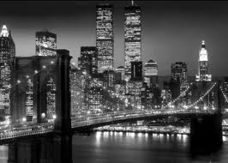
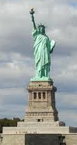
New York City study (1966)
By William Labov

Slide 29
New York City study (1966)
Labov wanted to test his theory with a bigger population New York City
Incidence of final and post-vocalic /r/
While most American accents are rhotic, New York (and Boston) have distinctive non-rhotic accent
Post-Depression, such urban accents lost prestige, and rhotic midwest accent emerged as standard
Labov showed that rhotic use of /r/ reflected social class and aspiration, and was more widespread in younger speakers

Slide 30
Method
Not practical to interview speakers extensively, as on Martha’s Vineyard.
Instead, needed to quickly elicit possible /r/ pronunciations in both spontaneous and careful speech
Walked around 3 NYC department stores, asking the location of departments he knew were on the fourth floor
By pretending not to hear, he got each informant to pronounce the two words twice, once spontaneously, and once carefully

Slide 31
3 stores catering for distinct social groups:
Saks (upper),
Informants were shop workers at different grades, giving a further possible stratification
Macy’s (middle),
S. Klein (lower)

Slide 32
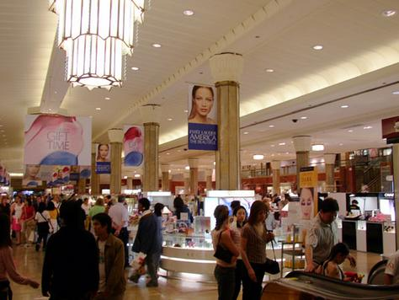
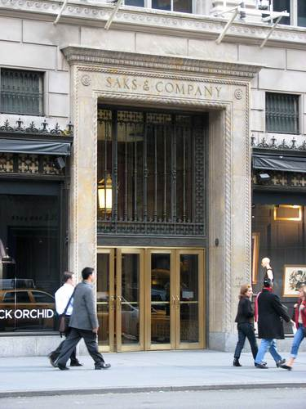
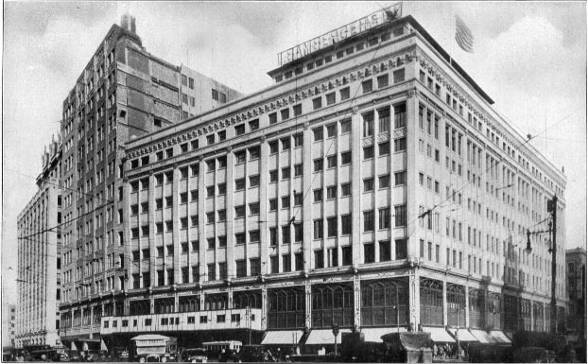

Slide 33
Results
Use of [r] corresponded to higher class of store
Furthermore, use of [r] increases in careful speech
Similar finding with rank of employee (management, sales, shelf-stackers)

Slide 34
Types of prestige
Overt vs covert
overt prestige: seeking prestige by assimilating to the standard
covert prestige: choosing to differ from the standard
Positive vs negative
positive: seeking prestige by adopting some feature
negative: seeking prestige by avoiding some feature

Slide 35
Another factor
Labov had expected results to reflect prestige, but difference between careful and casual pronunciation suggests other factors at work
Follow-up study looked at use of [r] in different styles of speech by different social classes

Slide 36
Pronunciation and style
Adoption of prestige form increases with formality of style, in each case with a higher baseline for higher classes
EXCEPT in one case

Slide 37
Hypercorrection
middle class outperform upper middle class on word lists and minimal pairs
this cross-over due to hypercorrection (according to Labov)
not sure whether results are statistically significant though
Labov reported group means, but did not indicate how much variance there was

Slide 38

Nastazia : Hypercorrection

Slide 39
Other studies
Labov studied other phonetic indicators such as pronunciation of th, ng, and h-dropping
Similar results

Slide 40
Conclusion
Labov established that a number of factors were involved, not just locale
Notably, not just class but also style
And prestige complicates matters

Slide 41
What to READ for this CLASS?
Chapter 3

Slide 42
References
Britain D. (2002). Dialectology. In David Bickerton (ed.), A Web Guide to Teaching and Learning in Languages, Linguistics and Area Studies. Southampton: Subject Centre for Languages, Linguistics and Area Studies.http://www.lang.ltsn.ac.uk/resources/goodpractice.aspx?resourceid=964 [Updated January 2005].
Britain D. (2002). Sociolinguistic Variation. In David Bickerton (ed.), A Web Guide to Teaching and Learning in Languages, Linguistics and Area Studies. Southampton: Subject Centre for Languages, Linguistics and Area Studies.http://www.lang.ltsn.ac.uk/resources/goodpractice.aspx?resourceid=1054 [Updated January 2005]

Slide 43
References
Labov W. (1963). The social motivation of a sound change. Word 19:273-309.
Labov W. (1966). The social stratification of English in New York City.
Washington DC: Center for Applied Linguistics
Labov W. (1970). The study of language in its social context. Studium Generale 23: 66-84
Wardhaugh R. (1986). An introduction to sociolinguistics. Oxford: Basil Blackwell
Holmes J. (1992) An introduction to sociolinguistics. London: Longman
http://www.hamline.edu/personal/aschramm/linguistics2001/4casestd.html
http://coral.lili.uni-bielefeld.de/~ttrippel/labov/node4.html

